Slide 1

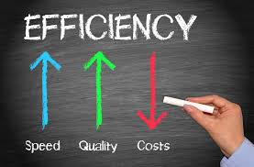
Ratio Analysis
Turnover Ratios

Slide 2
Learning Outcomes
Appraise the efficiency position of the business entities.
Recommend how businesses could improve their efficiency position.

Slide 3
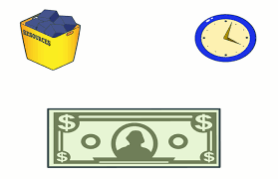
Turnover Ratios
Also known as ‘efficiency’ ratios
Measures ‘efficiency’ with which business manages it’s assets
Expressed in ‘Times’

Slide 4
Types of Turnover Ratios
Inventory turnover ratio
Debtors turnover ratio
Creditors turnover ratio
Inventory conversion period
Average collection period
Average payment period
Fixed assets turnover ratio

Slide 5
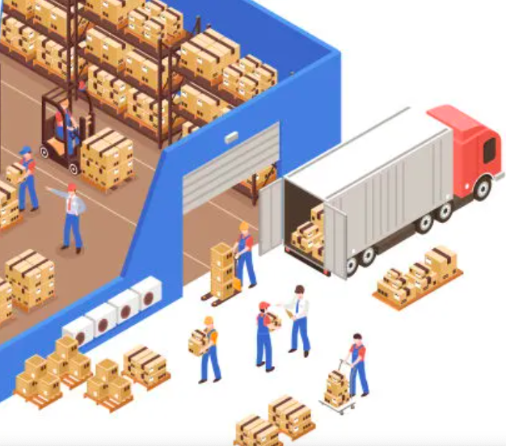
Stock (or inventory) turnover ratio
Shows efficiency with which ‘stock’ is converted into ‘sales’
Expressed as:
COGS
Average Stock

Slide 6
Interpretation of Stock Turnover Ratio
Very high turnover ratio
Low inventory levels
High turnover ratio
Efficiency of firm in managing its’ stock
Shows fast moving stock
Low turnover ratio
Slow moving stock
Excessive cash tied up in stock
Stock is quickly converted into cash
Inefficiency in managing its’ stock
Poor inventory management

Slide 7
Case Analysis
The following table presents the ‘inventory turnover ratio’ of the three major competitors in the grocery business for the year ended 31st March 2022.
Analyze the efficiency with which stock is turned over with regard to three competitors.
Particulars | D-Mart | Reliance Mart | Big Basket
Inventory Turnover Ratio | 10.08 | 4.03 | 16.13
The overall ‘Industry Average’ - Inventory Turnover Ratio is 9.18 times

Slide 8
B.) Inventory Conversion Period
Time Taken
Produce to product
Sell to product
Expressed as
Number of days/months/year
Inventory turnover ratio

Slide 9

Debtors Turnover Ratio
Efficiency with which debtors are converted to cash
Net Credit Sales
Average Debtors
Notes:
Average debtors = (opening debtors+ opening bills receivables) + (closing debtors+ closing bills receivables) /2

Slide 10
Interpretation of Debtors Turnover Ratio
Very High Debtors Turnover Ratio
Restrictive credit and collection policy
High Debtors Turnover Ratio
Shorter collection period
Prompt payment by debtors
Low Debtors Turnover Ratio
Delayed payments by debtors
Longer collection period
Very Low Debtors Turnover Ratio
Liberal and inefficient collection policy
Risk of bad debts

Slide 11
Case Analysis
The following table presents the ‘debtors turnover ratio’ of the three major competitors in the cement manufacturing business for the year ended 31st March 2022.
Analyze the efficiency with which debtors are turnover into cash with regard to three companies.
Particulars | Ambuja Cement Ltd. | ACC Ltd. | Ultratech Cement Ltd.
Debtors Turnover Ratio | 57.63 | 14.86 | 9.11
The overall ‘Industry Average’ - Debtors Turnover Ratio is 16 times

Slide 12
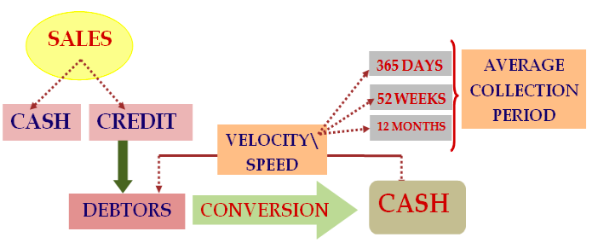
2.1) Debt collection period (or debtors velocity)
Shows the speed with which money/dues are collected from debtors
Debt collection period = 12 months/52 weeks/365 days
Debtors Turnover Ratio

Slide 13

3.) Creditors turnover ratio
Efficiency with which creditors are paid with cash
Expressed as
Net credit purchases
Average creditors
Notes:
Average creditors = (opening creditors+ opening bills payable) + (closing creditors+ closing bills payable) /2

Slide 14
Interpretation of Creditors Turnover Ratio
High creditor turnover ratio
Shorter payment period
Availability of less credit
Low creditor turnover ratio
Larger payment period enjoyed by the firm
Availability of more credit
Early payments are made by the firm
Delay in payments by the firm

Slide 15
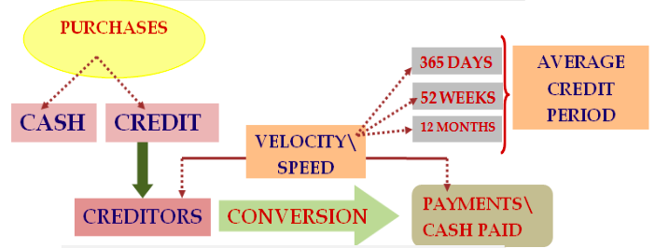
3.1) Debt payment period (or creditors velocity)
Average debt payment period = 365 days/52 weeks/12 months
Creditor Turnover Ratio

Slide 16

4.) Assets turnover ratio
Efficiency with which fixed assets are utilized, to generate sales
Sales
Average Total Assets
Notes:
Net assets = gross fixed operating assets – depreciation

Slide 17
Interpretation
High fixed assets turnover ratio
Low fixed assets turnover ratio
Efficient management and utilization of fixed assets
Inefficient management and utilization of fixed assets

